Slide 1
MEBP Update
MMAA Annual General Meeting 2020
Brad D. Collett, BComm(Hons), MAcc, CPA, CA
Notes:
Welcome to the MEBP Update for the 2020 MMAA AGM everyone.
Third presentation this month. Some of you saw my District Meeting presentation a week ago, while others listened to it on September 4th

Slide 2
MEBP AGM Presentation Agenda
September 25, 2020
Pension Plan
Disability & Group Insurance Plans
Frequently Asked Questions (and Answers!)
Your Questions

Slide 3
Pension Plan

Slide 4
How is our Pension invested?

Slide 5
Investment Review | June 2020
Manitoba Municipal Employees Pension Plan Executive Summary
Asset Class Weights
Normal Internal Market
Policy Exposure Value (m)
Canadian Bond Fund 34.00 25.92 195.89
Cash and Equivalents 1.00 0.57 4.34
Canadian Equities 12.00 9.77 73.83
Canadian XIC Equity Fund 2.81 21.25
Letko Brosseau 6.86 51.84
U.S. Equities 16.00 18.18 137.43
U.S. Large Cap Equity Fund 10.89 82.30
U.S. Low Volatility Dividend Equity Fund 2.31 17.43
U.S. Midcap Equity Fund 1.64 12.40
U.S. ETF Equity Fund 3.35 25.30
Non-North American Equities 18.00 20.21 152.77
International Equity Fund 4.35 32.84
Pan Asian Equity Fund 5.20 39.31
Emerging Markets Equity Fund 3.25 24.58
EAFE Equity Fund 7.42 56.04
Real Estate 10.00 13.50 102.06
Private Credit 1.00 4.70 35.55
Private Equity 4.00 0.30 2.26
Infrastructure 4.00 6.62 50.04
Forward Contract 0.21 1.60
Total 100.00 100.00 755.77
6

Slide 6
Who invests our Pension money?

Slide 7
The Civil Service Superannuation Board Investment Team
Peter Josephson, CFA: Chief Investment Officer
Peter has been with the investment team since 1999, after his tenure as Executive Vice - President & Chief Investment Officer wit h a large investment
management firm. He has been involved with managing money, establishing asset mix strategies, and making major investment dec isions for all asset classes.
Clancy Ethans, CFA: Managing Director, Alternative Assets and U.S. Equities
Clancy joined the investment team in December 2009 following his tenure of seven years as the Chief Investment Officer of Ric har dson Partners Financial
Limited. Before that he invested in private equity opportunities for the James Richardson & Sons, Limited. Prior to that, he managed a $500 million Canadian
equity fund for a large Manitoba pension fund.
Stephen Gannon, CFA: Manager, U.S. Equities
Stephen graduated from Manitoba's I.H. Asper School of Business and in 2005 became a CFA charterholder. Prior to joining the CSSB investment team in
2009, he worked for 10 years at an investment management firm in Winnipeg. Stephen currently co - manages the U.S. Equity portfoli os.
Chris Wutzke, CFA: Assistant Manager, U.S. Equities
Chris graduated from the University of Manitoba’s I.H. Asper School of Business and joined the CSSB investment team in 2001. In September 2006 he became
a CFA charterholder. Chris is responsible for the research, analysis, and recommendation of U.S. equities.
Maury Donen, CFA: Assistant Manager, U.S. Equities
After seven years in the private equity sector, Maury joined the investment team in 2003. He is responsible for leading detai led financial and operational due
diligence and post investment monitoring on Fund investments based in the U.S. financial markets. Maury is currently the Past Pr esident of CFA Winnipeg.
Tanner Prasek, Research Analyst, U.S. Equities
Tanner graduated from the University of Manitoba’s I.H. Asper School of Business in 2013 and spent time in Wealth Management and Treasury before joining
CSSB in 2018. In August 2017, he completed his CFA exams and will receive the charter after completion of required work experien ce. Tanner is responsible
for providing research, analysis, and recommendations for the US equity portfolios
Candy Wong, CFA: Manager, International Equities
Candy graduated from the University of Manitoba’s I.H. Asper School of Business and joined the CSSB investment team in 2004. In September 2006
she became a CFA charterholder. Prior to joining the CSSB investment team, Candy worked at an investment management firm for two years. She currently
manages the internal International Equity portfolio.
Guy Bru: Equity Trader / Operations Manager
Guy graduated from the University of Manitoba with a Bachelor of Arts Degree (Economics) in 1989. Guy joined the CSSB Investment team in 2019. Prior to
CSSB, Guy worked at a local mutual fund company as a Senior Equity Trader for 17 years. Guy is responsible for trading Canadian and U.S. equities.
3

Slide 8
The Civil Service Superannuation Board Investment Team
Jamie Chopek, CFA: Manager, Canadian Equities
Jamie graduated from the University of Manitoba’s I.H. Asper School of Business and joined the CSSB investment team in 2004. In 2007 he became a CFA
charterholder. Jamie currently manages one of the internal Canadian Equity portfolios.
Mandy Braun, CFA: Analyst, Canadian Equities
Mandy graduated from the University of Manitoba’s I.H. Asper School of Business in 2013. She was a recent competitor in the C FA’s 2013 Global Investment
Research Challenge. Mandy will be focused on the Canadian equity market.
Kris Drobot: Analyst, Canadian Equities
Kris graduated from the University of Manitoba's I.H. Asper School of Business in 2016 and joined the CSSB investment team later that year. Kris is
responsible for providing research, analysis, and recommendations on Canadian equities.
Ian Cameron, CFA: Senior Manager, Real Estate
Ian graduated from Manitoba's I.H. Asper School of Business and in 2010 became a CFA charterholder. Prior to joining the CSSB investment team in 2009, he
worked for two years at an investment management firm in Calgary. Ian currently manages the real estate portfolio.
Brent Muio, P.Eng., CFA: Senior Analyst, Alternative Investments & Real Estate
Brent graduated from Carleton University’s Aerospace Engineering program and in 2016 became a CFA charterholder. Prior to joi ning the CSSB investment
team in 2017, he worked for 12 years in the Aerospace and Utility industries. Brent is responsible for providing research, an alysis and recommendations to the
Alternative Investments (Infrastructure, Private Credit & Private Equity) and Real Estate portfolios.
Jon Janz, MBA, CFA: Manager, Fixed Income
Jon joined the investment team in 2008 after 20 years of portfolio management experience at a major insurance company. That e xperience includes managing
portfolios in Canadian and U.S. dollars as well as a wide range of fixed income products.
Sean Morgan, CFA: Analyst, Fixed Income
Sean graduated from the University of Manitoba's I.H. Asper School of Business in 2008 and joined the CSSB investment team in 2011. In April 2012
he became a CFA charterholder. Prior to joining the CSSB, he worked at a commercial finance company for three years. Sean is res ponsible for providing
research, analysis and recommendations to the Fixed Income portfolio.
Georgina Evanchow: Investment Assistant
Georgina has been with the investment team since November 2004. She worked previously at a large investment management firm for over 15 years. Georgina
is responsible for the short- term investment portfolio and daily administrative support.
4

Slide 9
How is our Pension Plan doing so far this year?

Slide 10
MARKET ENVIRONMENT
Year-to-Date June 30, 2020
Equity Markets
S&P/TSX Composite Index
S&P/TSX Completion Index
S&P/TSX Small Cap Index
S&P 500
S&P 500 Low Volatility
Custom Russell 3000
Russell Midcap Total Return
Custom MSCI EAFE Net
Custom MSCI EMF Net
Fixed Income and Cash Markets
FTSE Canada 91 Day T-Bill
FTSE Canada Universe
FTSE Canada Long Term
-7.47 %
-11.79 %
-14.28 %
1.80 %
-9.18 %
1.38 %
-4.55 %
-6.88 %
-5.25 %
0.77 %
7.53 %
11.35 %
2

Slide 11
2020 Year-to-Date Returns
March 31 -8.66%
April 30 -3.75%
July 31 +1.32%
August 31……..

Slide 12
MEPP Returns Summary
August 31, 2020
Fund MV % of 3 Months YTD 1 Year 4 Years 5 Years
Market Value (m) Fund Fund Index Var Fund Index Var Fund Index Var Fund Index Var Fund Index Var
Cash & Cash Equivalents 8 1.1 0.10 0.06 0.04 0.83 0.81 0.02 1.44 1.36 0.08 1.37 1.15 0.22 1.25 1.00 0.25
Canadian Bond Fund 196 25.1 2.35 2.14 0.21 9.00 8.63 0.37 6.68 6.28 0.40 4.51 4.33 0.18 5.26 5.00 0.26
Canadian XIC Equity Fund 23 2.9 9.78 9.66 0.12 -1.02 -1.05 0.03 n/a n/a n/a n/a n/a n/a n/a n/a n/a
Letko Brosseau 56 7.2 10.04 9.57 0.47 -17.45 -1.05 -16.40 -10.87 3.80 -14.67 n/a n/a n/a n/a n/a n/a
Total CDN Equity 80 10.2 10.16 9.57 0.59 -12.65 -1.05 -11.60 -6.95 3.80 -10.75 0.67 6.34 -5.67 2.46 6.81 -4.35
U.S. Large Cap Equity Fund 91 11.6 10.20 8.86 1.34 15.02 10.27 4.75 25.19 19.56 5.63 15.01 14.74 0.27 13.77 14.14 -0.37
U.S. Low Volatility Dividend Fund 18 2.3 1.84 -2.03 3.87 -3.44 -19.19 15.75 0.60 -18.25 18.85 n/a n/a n/a n/a n/a n/a
U.S. Midcap Equity Fund 13 1.7 5.03 5.03 0.00 -0.26 -0.04 -0.22 n/a n/a n/a n/a n/a n/a n/a n/a n/a
U.S. ETF Equity Fund 24 3.1 8.80 8.80 0.00 10.25 10.17 0.08 19.52 19.45 0.07 n/a n/a n/a n/a n/a n/a
Total U.S. Equity 146 18.7 8.40 7.34 1.06 10.11 5.94 4.17 18.80 13.88 4.92 13.20 13.39 -0.19 12.33 13.06 -0.73
International Equity Fund 32 4.1 4.94 5.33 -0.39 -4.91 -3.86 -1.05 3.56 4.65 -1.09 5.24 5.81 -0.57 4.22 4.90 -0.68
Mackenzie Investments Asia Limited 43 5.5 14.47 12.00 2.47 7.72 4.91 2.81 21.96 15.13 6.83 12.84 8.92 3.92 11.82 9.36 2.46
Somerset 26 3.4 14.92 12.68 2.24 -2.33 0.93 -3.26 8.53 12.26 -3.73 7.34 7.69 -0.35 8.45 8.35 0.10
Marathon M-L 57 7.3 5.53 4.88 0.65 -5.00 -4.16 -0.84 5.13 4.07 1.06 5.52 5.78 -0.26 4.27 4.42 -0.15
Total N.N.A. Equity 158 20.2 9.10 7.31 1.79 -1.48 -2.30 0.82 9.32 6.94 2.38 7.48 6.83 0.65 6.64 5.77 0.87
Brookfield SREP 4 0.5 -4.71 -1.04 -3.67 -2.89 -1.57 -1.32 6.57 1.65 4.92 n/a n/a n/a n/a n/a n/a
Keystone Real Estate Fund 98 12.6 0.41 -1.04 1.45 0.73 -1.57 2.30 7.73 1.65 6.08 9.04 6.35 2.69 9.24 6.25 2.99
Total Real Estate 102 13.0 0.21 -1.04 1.25 0.57 -1.57 2.14 7.60 1.65 5.95 8.99 6.35 2.64 9.19 6.25 2.94
Antares Capital 12 1.5 -0.27 2.04 -2.31 12.17 3.91 8.26 11.22 5.31 5.91 n/a n/a n/a n/a n/a n/a
Brookfield REFF 5 0.6 2.00 2.04 -0.04 4.14 3.91 0.23 8.11 5.31 2.80 n/a n/a n/a n/a n/a n/a
Carlyle Credit Opportunities Fund 2 0.2 -6.72 2.04 -8.76 -3.60 3.91 -7.40 n/a n/a n/a n/a n/a n/a n/a n/a n/a
Grosvenor True North II 3 0.4 16.83 2.04 14.79 10.56 3.91 6.65 15.19 5.31 9.88 n/a n/a n/a n/a n/a n/a
Northleaf Private Credit I 6 0.8 -0.06 2.04 -2.10 1.88 3.91 -2.03 6.14 5.31 0.83 n/a n/a n/a n/a n/a n/a
Northleaf Private Credit II 3 0.4 1.99 2.04 -0.05 3.81 3.91 0.01 n/a n/a n/a n/a n/a n/a n/a n/a n/a
Sagard Credit Partner 4 0.5 0.80 2.04 -1.24 1.69 3.91 -2.22 7.46 5.31 2.15 n/a n/a n/a n/a n/a n/a
Total Private Credit 34 4.4 1.28 2.04 -0.76 6.16 3.91 2.25 8.21 5.31 2.90 n/a n/a n/a n/a n/a n/a
Brookfield Capital Partners 1 0.2 -1.34 0.00 -1.34 4.60 0.00 4.60 n/a n/a n/a n/a n/a n/a n/a n/a n/a
Brookfield Panther 1 0.1 -0.03 0.00 -0.03 -0.09 0.00 -0.09 -0.53 0.00 -0.53 n/a n/a n/a n/a n/a n/a
Total Private Equity 2 0.3 -28.91 0.67 -29.58 -27.13 1.48 -28.61 -80.68 2.63 -83.31 -44.79 7.18 -51.97 -42.08 7.48 -49.56
Borealis 27 3.5 -0.16 2.04 -2.20 2.88 3.91 -1.03 7.61 5.31 2.30 10.70 6.83 3.87 10.56 6.67 3.89
Brookfield Infrastructure III 5 0.6 -4.91 2.04 -6.95 -1.14 3.91 -5.05 8.86 5.31 3.55 13.23 6.83 7.33 n/a n/a n/a
InstarAGF - Amport 1 0.1 -8.62 2.04 -10.66 -3.58 3.91 -7.49 2.57 5.31 -2.74 n/a n/a n/a n/a n/a n/a
InstarAGF Essential Infrastructure I 6 0.7 1.68 2.04 -0.36 3.98 3.91 0.07 10.98 5.31 5.67 11.00 6.83 5.10 n/a n/a n/a
InstarAGF Essential Infrastructure II 2 0.2 0.06 2.04 -1.98 -1.93 3.91 -5.73 n/a n/a n/a n/a n/a n/a n/a n/a n/a
InstarAGF Midstream 1 0.1 -0.97 2.04 -3.01 5.25 3.91 1.45 18.83 5.31 13.08 n/a n/a n/a n/a n/a n/a
InstarAGF Project Wrangler 1 0.1 2.19 2.04 0.15 12.97 3.91 9.06 21.42 5.31 15.67 n/a n/a n/a n/a n/a n/a
Northleaf Infrastructure Capital Partners II 6 0.7 4.92 2.04 2.88 11.04 3.91 7.13 15.95 5.31 10.64 9.05 6.83 3.15 n/a n/a n/a
Northleaf NWP 1 0.2 -0.10 2.04 -2.14 17.16 3.91 13.25 21.86 5.31 16.55 n/a n/a n/a n/a n/a n/a
Total Infrastructure
50 6.4
-0.13
.
2.04
.
-2.17 3.61 3.91 -0.30
. . . .
9.40
.
5.31
.
4.09 11.09 6.83 4.26 10.86 6.67 4.19
. . . . . . .
Total Fund 779 100.0 4.92 4.41 0.51 2.57 3.80 -1.23 6.95 7.06 -0.11 6.63 7.08 -0.45 6.54 7.12 -0.58

Slide 13
Plan Rates of Return by Year

Slide 14
Municipal Pension Plan Historic Rates of Return
2005 | 14.68%
2006 | 12.13%
2007 | 3.40%
2008 | -16.80%
2009 | 14.50%
2010 | 12.90%
2011 | -0.50%
2012 | 9.36%
2013 | 12.27%
2014 | 9.22%
2015 | 7.16%
2016 | 5.24%
2017 | 10.40%
2018 | -0.51%
2019 | 12.50%

Slide 15
Disability & Group Insurance

Slide 16
How is our Disability & Group Insurance Money Invested?

Slide 17
Asset Mix at Quarter End
Cash
4.3%
Cash
7.0%
Trez
Prime
Trez
Prime
Cortland
32.5%
30.4%
Trez
Yield
32.8%
Cortland
Credit
31.1%
30.3%
Trez
Yield
31.5%
Group Life Disability
5

Slide 18
How much money is invested in each Plan?

Slide 19
Disability Plan
Cash | $1,232,602
Cortland Credit | $3,880,726
Trez Capital Prime Trust | $3,768,928
Trez Capital Yield Trust | $3,919,654
TOTAL | $12,801,910

Slide 20
Group Insurance
Cash | $886,680
Cortland Credit | $3,055,308
Trez Capital Prime Trust | $2,845,974
Trez Capital Yield Trust | $3,086,999
TOTAL | $9,874,961

Slide 21
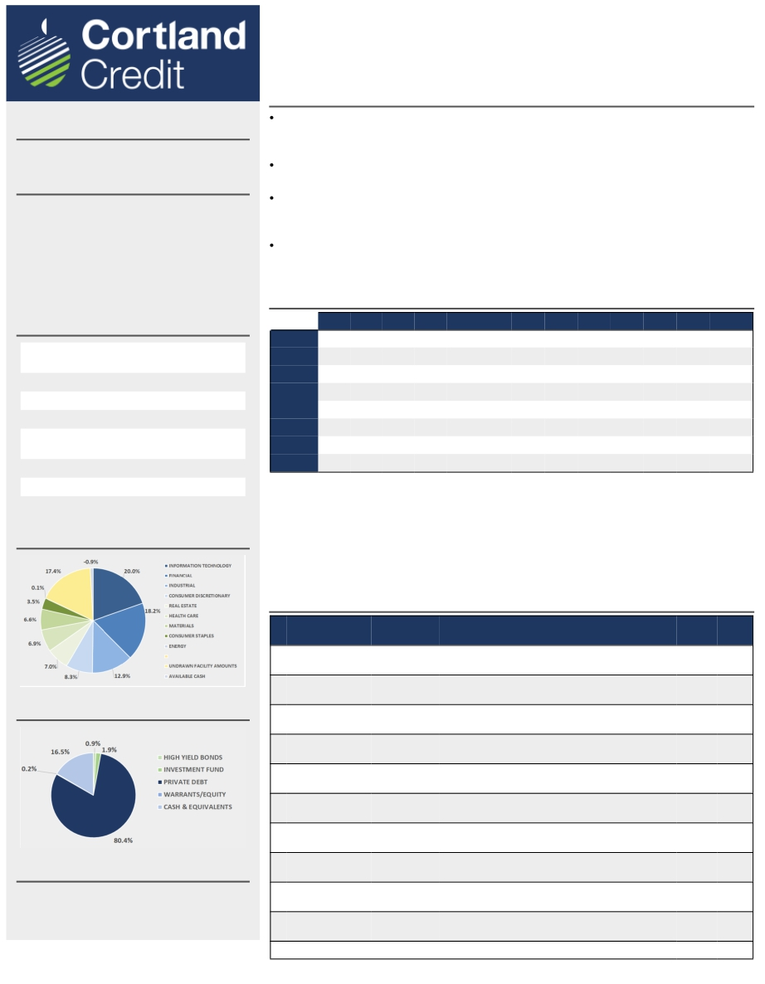
Cortland Credit Strategies LP - Series F
Short-Term Private Debt
Performance as of June 30, 2020
Also available in RRSP version
FUND STRATEGY
Provide a stable income investment opportunity by acquiring a por olio of diversified short
term private debt, with peripheral exposures to short term Mortgages and public High Yield
and Corporate/Government securi es
Focus on short dura on debt instruments to reduce interest rate sensi vity and achieve the
Fund’s liquidity objec ves
Execute origina on strategies within robust Por olio Management Guidelines, Investment
Controls and Restric ons to provide prudent diversifica on while delivering superior risk-
adjusted returns
Apply stringent investment review pla orm employing fundamental bo om-up analysis to
select only companies with lower risk of default and to maximize protec on through the capital
structure
MONTHLY RETURNS SINCE INCEPTION (%)
Jan Feb Mar Apr May Jun Jul Aug Sep Oct Nov Dec YTD
2020 0.49 0.45 0.33 0.42 0.53 0.50 2.77%
MANAGER
Cortland Credit Group Inc.
FUND INVESTMENT OBJECTIVE
To preserve capital and generate uncorrelated
returns that meet or exceed performance
targets through cross class, short dura on
debt investments. The Fund aims to provide a
superior fixed income investment vehicle with
a dis nct debt capital strategy for retail and
ins tu onal investors.
FUND DETAILS
Date of incep on
AUM
NAV Per Unit
Management Fee
Opera ons/Underwri ng
Expense
September 9,
2013
$474.2 MM
$11.7637
0.45%
1.70%
2019 0.41 0.52 0.48 0.43 0.35 0.75 0.40 0.53 0.48 0.55 0.56 0.61 6.23%
2018 0.49 0.45 0.48 0.43 0.43 0.41 0.67 0.52 0.60 0.49 0.49 0.51 6.12%
2017 0.50 0.46 0.55 0.51 0.46 0.45 0.42 0.35 0.40 0.62 0.56 0.48 5.92%
2016 0.45 0.44 0.54 0.61 0.41 0.49 0.54 0.50 0.48 0.56 0.47 0.52 6.18%
2015 0.62 0.36 0.49 0.53 0.43 0.41 0.41 0.41 0.49 0.48 0.46 0.44 5.68%
2014 0.48 0.43 0.44 0.42 0.43 0.43 0.47 0.43 0.43 0.44 0.44 0.43 5.40%
Latest Distribu on
Distribu on Frequency
$0.0593
Monthly
2013
PERIODIC AND ANNUALIZED RETURNS
0.24 0.24 0.40 0.33 1.21%
Distribu ons Since Incep on $3.323
EXPOSURE BY SECTOR
Period 1 mo 3 mo 6 mo 1 yr 3 yr 5 yr Incep on
Fund Performance 0.50% 1.47% 2.77% 6.02% 6.02% 6.00% 5.78%
*All performance shown is the F-Series of the Cortland Credit Strategies LP, net of fees. Returns include changes in
the unit value and assumes reinvestment of all distribu ons and do not take into account sales, redemp on,
distribu on, or op onal charges or incomes taxes payable by any unitholder that would have reduced returns.
TOP 10 INVESTMENTS
#
Type
Industry
Descrip on
# of
Obligors
Weight
1
Senior Secured
Revolver
Informa on
Technology
IT products & services
8 10%
2
3
Senior Secured
Revolver
Senior Secured
Revolver
Industrial
Consumer
Discre onary
Purchase order & AR financing for a solar panel
manufacturer
AR factoring for a security equipment distributor
90 7%
1199 7%
EXPOSURE BY SECURITY TYPE
4
Senior Secured
Short Term Loan
Financial
Short-term loan to support a leading Canadian fintechs
loan origina on
1241 6%
5
Senior Secured
Short Term Loan
Materials
Bridge loan to support the acquisi on of a mining mill in
Australia
1
5%
6
Senior Secured
Short Term Loan
Healthcare
Bridge loan for a health care and natural food product
provider
1
4%
7
Senior Secured
Revolver
Real Estate
Mortgage financing
257 4%
Fundserv CODES
8
Senior Secured
Short Term Loan
Consumer
Staples
Bridge loan to support the shareholder buyout and
growth of an Ontario based cra brewer
1
3%
CCSLP - F : CCG100
CCSLP - A : CCG102
9
Senior Secured
Short Term Loan
Financial Credit facility for Canadian based credit card receivables 1
3%
10
Senior Secured
Revolver
Informa on
Technology
AR financing for Value Added Reseller of IT products &
services
257 3%
Total: 3056 52%

Slide 22
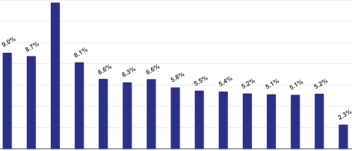
FUND FACT SHEET F Series Units
June 30, 2020
FundServ Code Unit Class Trailer Fee
TRZ 410 F Series N/A
Trez Capital Prime Trust's investment objective is to preserve invested capital, while generating a consistent rate of interest income by investing in a
diversified portfolio of conservative commercial and multi-residential, first position mortgages which do not exceed 75% of the value of the real property
at the time of funding.
All amounts are expressed in CAD unless otherwise specified
FUND DETAILS
Fund Type
Eligibility
Purchase
Management
Fee
Distribution
Frequency
Open-ended pooled mortgage fund
RRSP, RRIF, DPSP, RDSP, RESP, TFSA, IPP
T + 2
1.50%
Monthly
Inception
Unit Value
Redemption
Incentive Fee
Target Return
January 1, 2006
$10
Currently monthly liquidity with limits 2
10% of net operating income
5% per annum
2 Please contact your Trez Capital representative for additional information
PERFORMANCE HISTORY (DRIP)
16%
14%
12%
10%
8%
6%
4%
2%
0%
2006 2007 2008 2009 2010 2011 2012 2013 2014 2015 2016 2017 2018 2019 2020
YTD
All reported returns are net of fees
MANAGER SUMMARY
Manager
Manager AUM
Fund AUM
PERIOD
Since Inception
10 - Year
5 - Year
3 - Year
1 - Year
Trez Capital Fund Management
Limited Partnership
Greater than $3.8 Billion 1
$388,900,875
1 Estimated as at June 30, 2020
RETURN
6.9%
5.7%
5.2%
5.1%
5.2%
Annualized returns as at December 31, 2019
PORTFOLIO DIVERSIFICATION
SECURITY RANK
First Mortgages (100.0%)
ASSET CLASS
Residential (62.5%)
Office (13.3%)
Industrial (10.6%)
Hotel (9.6%)
Retail (4.0%)
GEOGRAPHIC REGION
British Columbia (32.7%)
Alberta (15.4%)
Texas (11.3%)
Georgia (8.2%)
Washington (5.7%)
Florida (5.5%)
Eastern Canada (1.4%)
U.S. West Region - Other (14.5%)
PORTFOLIO METRICS
Number of Loans
Weighted Average LTV
Weighted Average
Term-to-Maturity
(Months)
62
53.1%
11.0
U.S. South Region - Other (5.3%) Unaudited and non-consolidated, as at June 30, 2020
THE TREZ FAMILY OF FUNDS
Through its five unique debt funds, Trez Capital provides investors with the broadest range of mortgage debt investment products. These funds encompass private investment products sold through
registered investment dealers. They also cater to different risk profiles and provide exposure to both Canadian and U.S. mortgage markets. Since 1997, Trez Capital has funded over 1,513 loans
totaling more than $11.5 Billion CAD and is one of Canada’s largest non-bank commercial mortgage lenders.
FOR FURTHER INFORMATION, PLEASE CONTACT
Investor Services
T: 1.877.689.0821
E: investor-services@trezcapital.com
www.trezcapital.com
These materials are not to be distributed, reproduced or communicated to a third party without the express written consent of Trez Capital Fund Management Limited Partnership. These materials should be read
in conjunction with the Offering Memorandum dated April 30, 2020 including the risk factors identified therein. These materials are for informational purposes only and do not constitute an offer to sell or a
solicitation to buy securities. Past results are not indicative of future performance.
.

Slide 23
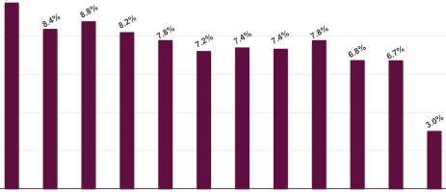
FUND FACT SHEET F Series Units
June 30, 2020
FundServ Code Unit Class Trailer Fee
TRZ 110 F Series N/A
Trez Capital Yield Trust's investment objective is to preserve capital, while delivering an attractive, consistent rate of interest income by investing in a
diversified portfolio of commercial and multi-residential mortgages in Canada and the United States.
All amounts are expressed in CAD unless otherwise specified
FUND DETAILS
Fund Type
Eligibility
Purchase
Management
Fee
Distribution
Frequency
Open-ended pooled mortgage fund
RRSP, RRIF, DPSP, RDSP, RESP, TFSA, IPP
T + 2
1.50%
Monthly
Inception
Unit Value
Redemption
Incentive Fee
Target Return
June 2009
$10
Currently monthly liquidity with limits 2
10% of net operating income
6.5% per annum
2 Please contact your Trez Capital representative for additional information
PERFORMANCE HISTORY (DRIP)
12%
10%
8%
6%
4%
2%
0%
2009 2010 2011 2012 2013 2014 2015 2016 2017 2018 2019 2020 YTD
All reported returns are net of fees
MANAGER SUMMARY
Manager
Manager AUM
Fund AUM
PERIOD
Since Inception
10 - Year
5 - Year
3 - Year
1 - Year
Trez Capital Fund Management
Limited Partnership
Greater than $3.8 Billion 1
$1,263,042,425
1 Estimated as at June 30, 2020
RETURN
7.8%
7.6%
7.2%
7.1%
6.7%
Annualized returns as at December 31, 2019
PORTFOLIO DIVERSIFICATION
SECURITY RANK
First Mortgages (70.9%)
Second Mortgages (19.5%)
Blanket Mortgages (9.6%)
ASSET CLASS
Residential (67.0%)
Industrial (11.7%)
Office (8.2%)
Hotel (6.6%)
Retail (6.3%)
Other (0.2%)
GEOGRAPHIC REGION
Alberta (35.5%)
British Columbia (21.1%)
Texas (11.7%)
Eastern Canada (6.8%)
Oregon (4.1%)
U.S. South Region - Other (11.7%)
U.S. West Region - Other (8.8%)
U.S. - Other Regions (0.3%)
PORTFOLIO METRICS
Number of Loans
Weighted Average LTV
Weighted Average
Term-to-Maturity
(Months)
197
70.5%
10.1
Unaudited and non-consolidated, as at June 30, 2020
THE TREZ FAMILY OF FUNDS
Through its five unique debt funds, Trez Capital provides investors with the broadest range of mortgage debt investment products. These funds encompass private investment products sold through
registered investment dealers. They also cater to different risk profiles and provide exposure to both Canadian and U.S. mortgage markets. Since 1997, Trez Capital has funded over 1,513 loans
totaling more than $11.5 Billion CAD and is one of Canada’s largest non-bank commercial mortgage lenders.
FOR FURTHER INFORMATION, PLEASE CONTACT
Investor Services
T: 1.877.689.0821
E: investor-services@trezcapital.com
www.trezcapital.com
These materials are not to be distributed, reproduced or communicated to a third party without the express written consent of Trez Capital Fund Management Limited Partnership. These materials should be read
in conjunction with the Offering Memorandum dated April 30, 2020 including the risk factors identified therein. These materials are for informational purposes only and do not constitute an offer to sell or a
solicitation to buy securities. Past results are not indicative of future performance.

Slide 24
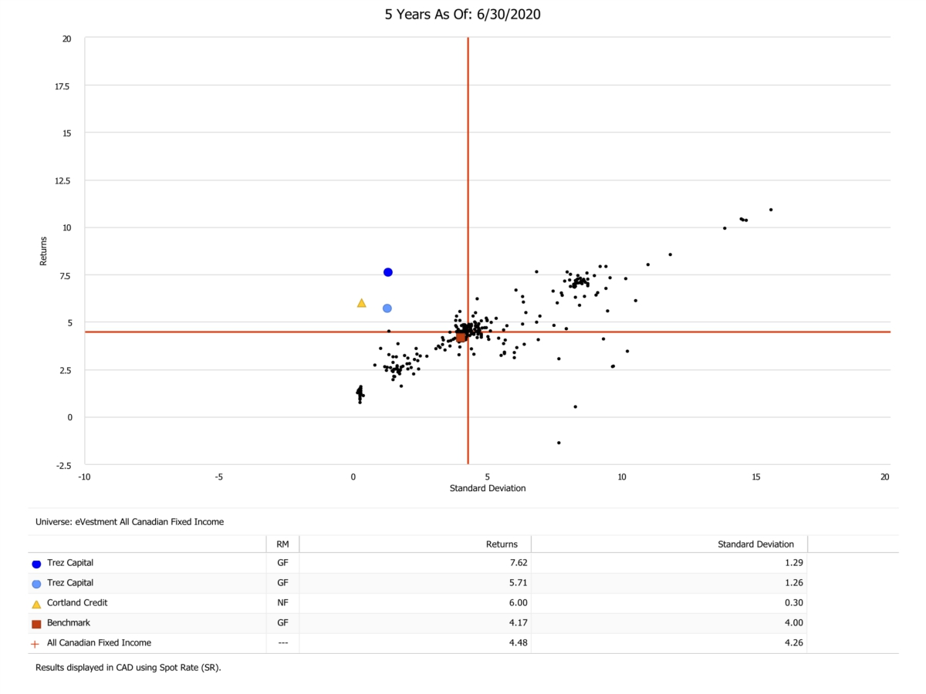

Slide 25
Frequently Asked Questions

Slide 26
1. Who is on the Board of Trustees of MEBP?

Slide 27
MEBP Board of Trustees
Employer
Stuart Olmstead, Mayor, Town of Carberry
Martin Harder, Mayor, City of Winkler
Mervin Starzyk, Mayor, RM of Yellowhead
Karen MacKinnon, Councillor, City of Flin Flon

Slide 28
MEBP Board of Trustees
Employees
Tanya Addison, MMAA (Elected)
Adam Philpott, MMAA (Elected)
Brad Collett, MMAA (Appointed)
Elizabeth Carlyle, CUPE (Appointed)

Slide 29
2. How do our Pension Plan contribution rates compare to other Canadian municipal plans?

Slide 30
Municipal Pension Plan Contribution Rates
 |  | Below YMPE |  | Above YMPE
MEBP |  | 8.3% |  | 9.5%
MEPP (Saskatchewan) |  | 9.0% |  | 12.5%
LAPP (Alberta) |  | 8.39% |  | 12.84%
MPP (British Columbia) |  | 8.5% |  | 10.0%
OMERS (Ontario) |  | 9.0% |  | 14.6%
* YMPE = Yearly Maximum Pensionable Earnings

Slide 31
3. How many people are in our Pension Plan?

Slide 32
MEBP Pension Plan Participants
Active - 3,635
Deferred - 466
Retired - 2,391

Slide 33
Your Questions

